Slide 1
Dr.Suman Chandra Mohanta
Associate Professor
Department of Chemistry
Jashore University of Science and Technology

Slide 2
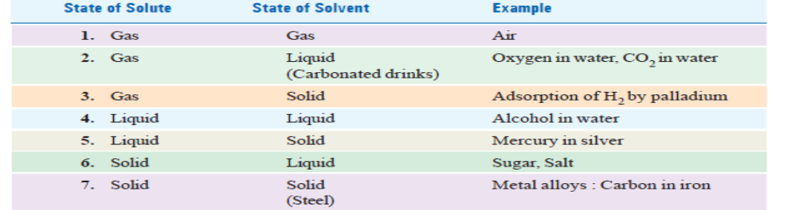
Solution
A solution is a homogeneous mixture of two or more substances on molecular level. The constituent of the mixture present in a smaller amount is called the Solute and the one present in a larger amount is called the Solvent.
TYPES OF SOLUTIONS

Slide 3




CONCENTRATION OF A SOLUTION
Concentration = Quantity of solute
Volume of solution
Per cent by Weight
MOLE FRACTION
MOLARITY
MOLALITY

Slide 4

NORMALITY
Henry’s Law
For a gas in contact with a solvent at constant temperature, concentration of the gas that dissolves in the solvent is directly proportional to the pressure of the gas.
Mathematically, Henry’s Law may be expressed as
C α P
or C = k P
Limitations of Henry’s Law
It applies closely to gases with nearly ideal behaviour.
(1) at moderate temperature and pressure.
(2) if the solubility of the gas in the solvent is low.
(3) the gas does not react with the solvent to form a new species. Thus ammonia (or HCl) which react with water do not obey Henry’s Law.
NH3 + H2O = NH4+ + OH–
(4) the gas does not associate or dissociate on dissolving in the solvent.

Slide 5
Solubility:
The solubility is defined as the concentration of the solute in solution when it is in equilibrium with the solid substance at a particular temperature. The solubility of a substance is often expressed in terms of number of grams of it that can be dissolved in 100 grams of the solvent.
When a saturated solution prepared at a higher temperature is cooled, it gives a solution which would contain more solute than the saturated solution at that temperature. Such a solution is called a supersaturated solution.
SOLUBILITY CURVES
A curve drawn between solubility and temperature is termed Solubility Curve. It shows the effect of temperature on the solubility of a substance.
In general, the solubility curves are of two types :
(1) Continuous solubility curves
(2) Discontinuous solubility curves

Slide 6
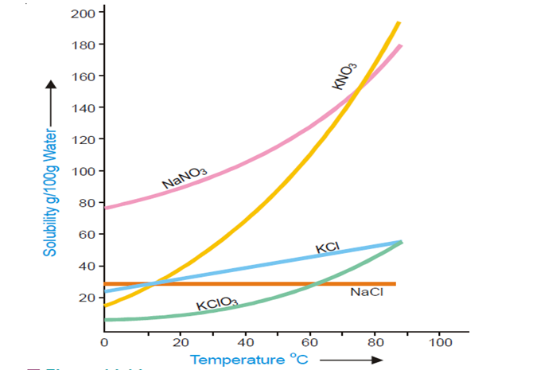
Continuous solubility curves.

Slide 7
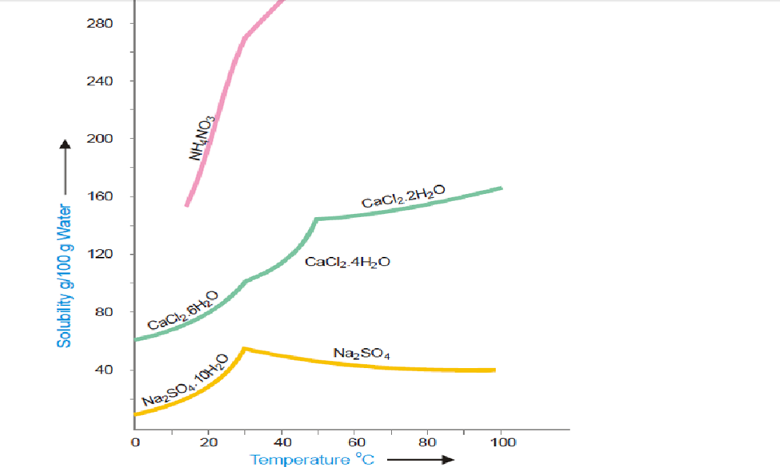
Discontinuous solubility curves

Slide 8
Problems
SOLVED PROBLEM 1: What is the molarity of a solution prepared by dissolving 75.5 g of pure KOH in 540 ml of solution
SOLVED PROBLEM 2: What weight of HCl is present in 155 ml of a 0.540 M solution?
SOLVED PROBLEM 3: What is the molality of a solution prepared by dissolving 5.0 g of toluene (C7H8) in 225 g of benzene (C6H6) ?
SOLVED PROBLEM 4: 5 g of NaCl is dissolved in 1000 g of water. If the density of the resulting solution is 0.997 g per ml, calculate the molality, molarity, normality and mole fraction of the solute, assuming volume of the solution is equal to that of solvent.

Slide 9

COLLIGATIVE PROPERTIES
A colligative property may be defined as one which depends on the number of particles in solution and not in any way on the size or chemical nature of the particles.
Dilute solutions containing non-volatile solute exhibit the
following properties :
(1) Lowering of the Vapour Pressure
(2) Elevation of the Boiling Point
(3) Depression of the Freezing Point
(4) Osmotic Pressure
LOWERING OF VAPOUR PRESSURE
Relative lowering of Vapour pressure: The vapour pressure of a pure solvent is decreased when a non-volatile solute is dissolved in it. If p is the vapour pressure of the solvent and ps that of the solution, the lowering of vapour pressure is (p – ps). This lowering of vapour pressure relative to the vapour pressure of the pure solvent is termed the Relative lowering of Vapour pressure. Thus,

Slide 10
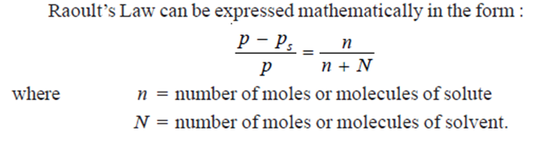
Raoult’s Law
The relative lowering of the vapour pressure of a dilute solution is equal to the mole fraction of the solute present in dilute solution

Slide 11
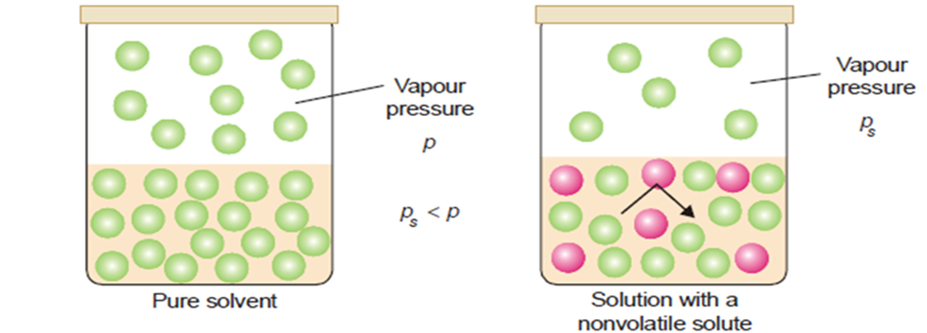
Derivation of Raoult’s Law
The vapour pressure of the pure solvent is caused by the number of molecules evaporating from its surface. When a nonvolatile solute is dissolved in solution, the presence of solute molecules in the surface blocks a fraction of the surface where no evaporation can take place. This causes the lowering of the vapour pressure. The vapour pressure of the solution is, therefore, determined by the number of molecules of the solvent present at any time in the surface which is proportional to the mole fraction. That is,

Slide 12
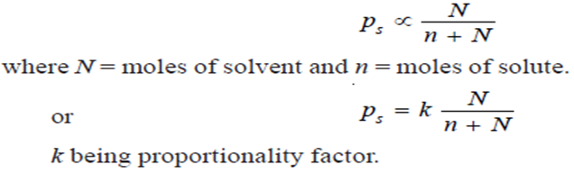
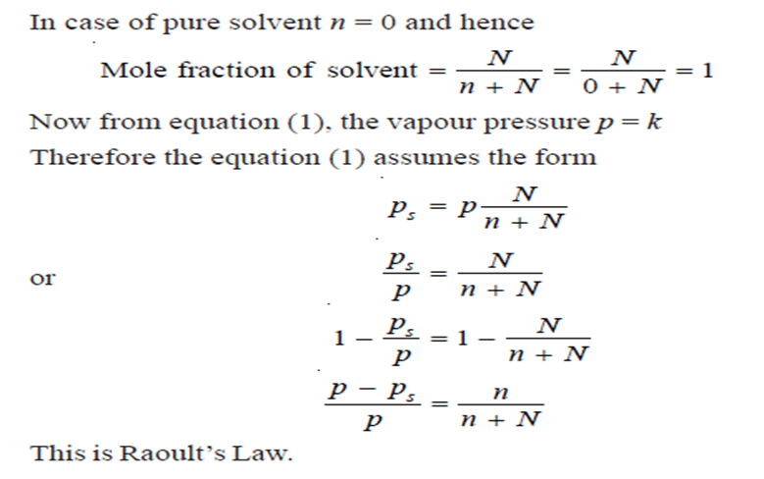

Slide 13
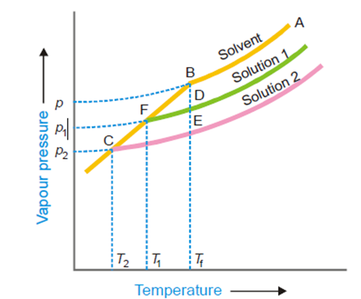
ELEVATION OF BOILING POINT
When a liquid is heated, its vapour pressure rises and when it equals the atmospheric pressure, the liquid boils. The addition of a non volatile solute lowers the vapour pressure and consequently elevates the boiling point as the solution has to be heated to a higher temperature to make its vapour pressure become equal to atmospheric pressure. If Tb is the boiling point of the solvent and T is the boiling point of the solution, the difference in the boiling points (ΔT) is called the elevation of boiling point.
T – Tb = ΔT
FREEZING–POINT DEPRESSION
The vapour pressure of a pure liquid changes with temperature as shown by the curve ABC, in Fig. There is a sharp break at B where, in fact, the freezing-point curve commences. Thus the point B corresponds to the freezing point of pure solvent, Tf. The vapour pressure curve of a solution (solution 1) of a nonvolatile solute in the same solvent is also shown in Fig. It is similar to the vapour pressure curve of the pure solvent and meets the freezing point curve at F, indicating that T1 is the freezing point of the solution. The difference of the freezing point of the pure solvent and the solution is referred to as the Depression of freezing point. It is represented by the symbol ΔT or ΔT_{f} .
T_{f} – T₁ = Δ T

Slide 14
OSMOTIC PRESSURE
The hydrostatic pressure built up on the solution which just stops the osmosis of pure solvent into the solution through a semipermeable membrane, is called Osmotic Pressure.
From a study of the experimental results obtained by Pfeffer, van’t Hoff showed that for dilute
solutions :
(a) The osmotic pressure of a solution at a given temperature is directly proportional to its concentration.
(b) The osmotic pressure of a solution of a given concentration is directly proportional to the absolute temperature.

Slide 15
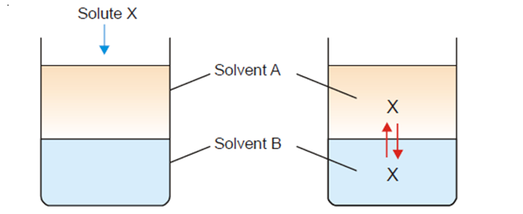
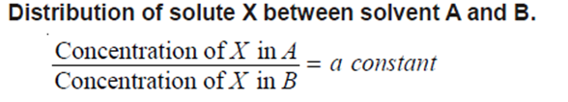
DISTRIBUTION LAW

Slide 16


STATEMENT OF NERNST’S DISTRIBUTION LAW
If a solute X distributes itself between two immiscible solvents A and B at constant temperatureand X is in the same molecular condition in both solvents,
If C1 denotes the concentration of the solute in solvent A and C2 the concentration in solvent B, Nernst’s Distribution law can be expressed as
The constant KD (or simply K) is called the Distribution coefficient or Partition coefficient or Distribution ratio.

Slide 17
LIMITATIONS OF DISTRIBUTION LAW
The conditions to be satisfied for the application of the Nernst’s Distribution law are
1. Constant temperature. The temperature is kept constant throughout the experiment.
2. Same molecular state. The molecular state of the solute is the same in the two solvents. The law does not hold if there is association or dissociation of the solute in one of the solvents.
3. Equilibrium concentrations. The concentrations of the solute are noted after the equilibrium has been established.
4. Dilute solutions. The concentration of the solute in the two solvents is low. The law does not hold when the concentrations are high.
5. Non-miscibility of solvents. The two solvents are non-miscible or only slightly soluble in each other. The extent of mutual solubility of the solvents remains unaltered by the addition
of solute to them.

Slide 18
APPLICATIONS OF DISTRIBUTION LAW
(1) Solvent Extraction
(2) Partition Chromatography
(3) Desilverization of Lead (Parke’s Process)
(4) Confirmatory Test for Bromide and Iodide
(5) Determination of Association
(6) Determination of Dissociation
(7) Determination of Solubility
(8) Distribution Indicators

Slide 19
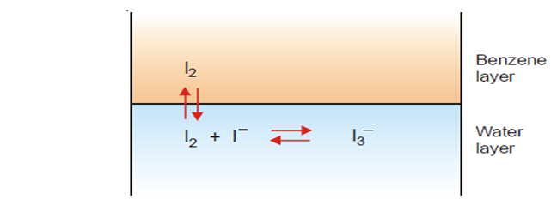

(9) Deducing the Formula of a Complex Ion (I3-)
Some iodine is added to a solution of KI and the reaction mixture shaken with benzene.
(a) The [I2] in water layer can be found knowing the value of KD (determined separately) and concentration of iodine in benzene (determined by titration against thiosulphate).
(b) The total concentration of iodine, [I2] + [I3−] in water layer is found by titration against thiosulphate. Knowing [I2] from (a), [I3− ] can be calculated.
(c) The initial concentration of KI taken is represented by the equilibrium concentrations [I–] + [I₃⁻ ]. Knowing [I₃⁻] from (b), [I–] can be found. Substituting the above values of concentrations in the law of Mass Action equation of the reaction in water layer, the value of equilibrium constant K can be calculated. If it comes out to be constant for different concentrations of iodine, it stands confirmed that the formula of the complex I₃⁻ , which we assumed is correct.

